Slide 1
WELCOME
TO
MY PRESENTATION
SUBMITTED BY:
UDIT KUMAR (20010903005)

Slide 2
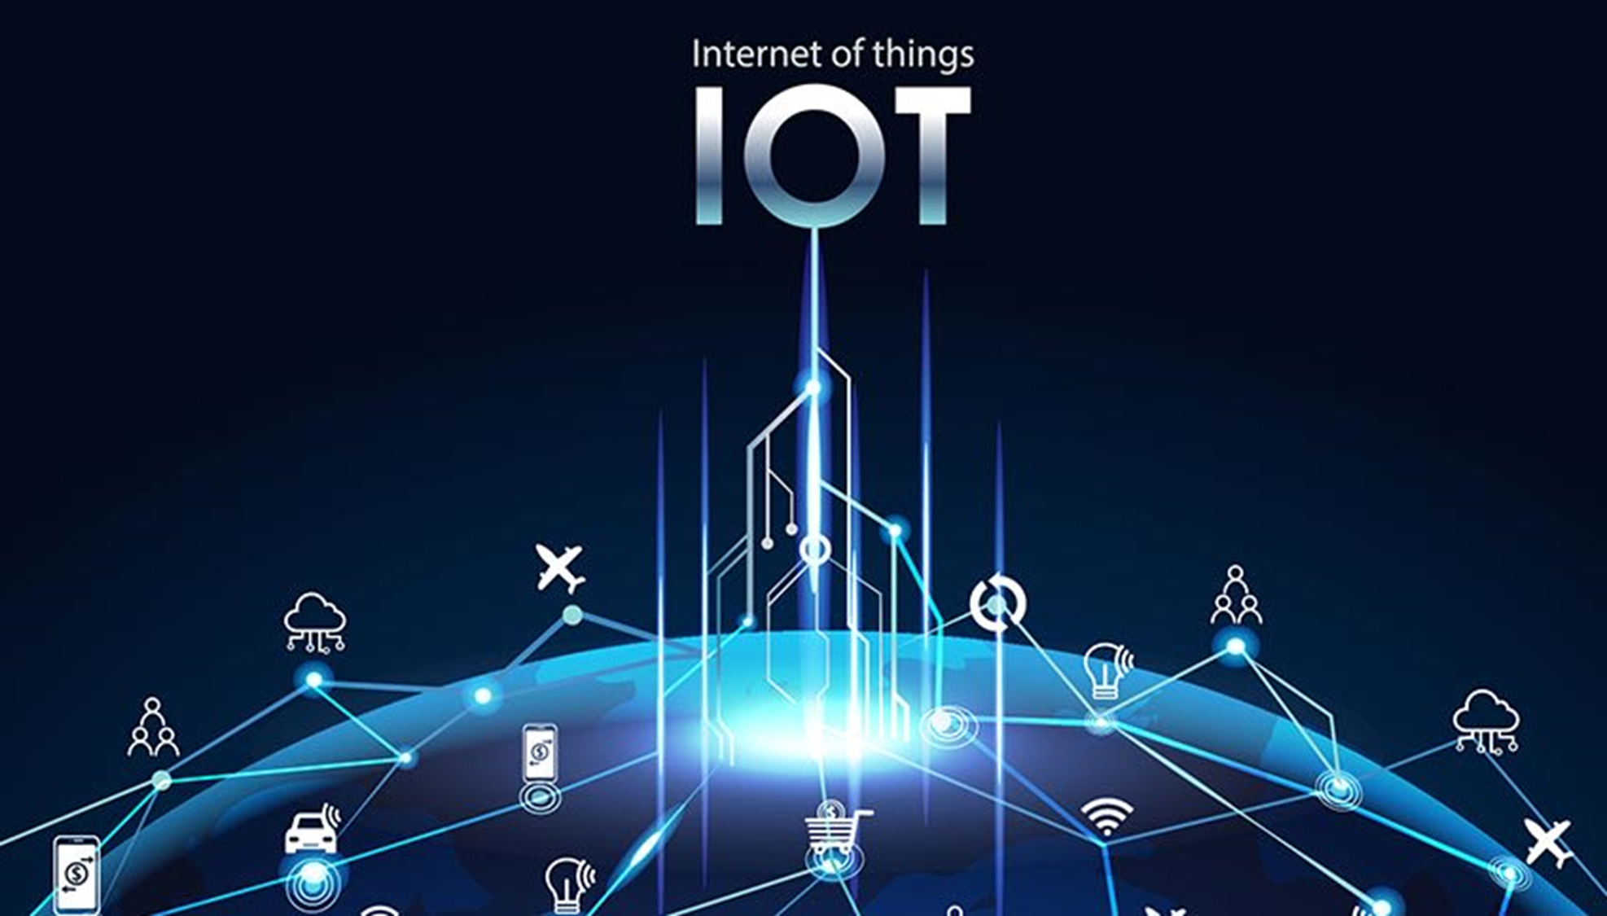

Slide 3
CONTENTS
DEFINITION
HISTORY OF IOT
HOW IOT WORK
EXAMPLE OF AN IOT DEVICES
IMPORTANCE OF IOT
BENEFITS OF IOT
IOT AS A NETWORK OF NETWORK
APPLICATION OF IOT
ADVANTAGES OF IOT
DISADVANTAGES OF IOT

Slide 4
DEFINITION
The Internet of Things is a system of interrelated computing devices, mechanical and digital machines, objects, animals or people that are provided with unique identifiers and the ability to transfer data over a network without requiring human to human or human to computer interaction.
The Internet of things describes the network of the physical things-”things”-that are embedded with sensor, software and other technologies for the purpose of connecting and exchanging data with other devices and system over the internet.

Slide 5
HISTORYOF IOT
1999- The team Internet of Things was used by Kevin Ashton during his work at P&G which became widely accepted.
2004 - The term was mentioned in famous publications like the Guardian, Boston Globe, and Scientific American.
2005-UN's International Telecommunications Union published its first report on this topic.
2008- The Internet of Things was born.
2011- Gartner, the market research company, include "The Internet of Things" technology in their research.

Slide 6
HOW IOT WORK
Sensors/ Devices
Connectivity
Data Processing
User Interface

Slide 7
SENSORS/ DEVICES
Sensors or devices are a key component that helps you to collect live data from the surrounding environment.
All this data may have various levels of complexities.
It could be a simple temperature monitoring sensor, or it may be in the form of the video feed.

Slide 8
2. CONNECTIVITY
All the collected data is sent to a cloud infrastructure.
The sensors should be connected to the cloud using various mediums of communications.
These communication mediums include mobile or satellite networks, Bluetooth, WI-FI, WAN, etc.

Slide 9
3. DATA PROCESSING
Once that data is collected, and it gets to the cloud, the software performs processing on the gathered data.
This process can be just checking the temperature, reading on devices like AC or heaters.
However, it can sometimes also be very complex like identifying objects, using computer vision on video.

Slide 10
4. USER INTERFACE
The information needs to be available to the end-user in some way which can be achieved by triggering alarms on their phones or sending them notification through email or text message.
The user sometimes might need an interface which actively checks their IoT system.
For example, the user has a camera installed in his home. He wants to access video recording and all the feeds with the help of a web server.

Slide 11
EXAMPLE OF AN IOT DEVICES
A lightbulb that can be switched on using a smartphone app is an IoT device, as is a motion sensor or a smart thermostat in your office or a connected streetlight.
An IoT device could be as fluffy as a child's toy or as serious as a driverless truck.
Some larger objects may themselves be filled with many smaller IoT components, such as a jet engine that's now filled with thousands of sensors collecting and transmitting data back to make sure it is operating efficiently.

Slide 12
IMPORTANCE OF IOT
Over the past few years, IoT has become one of the most important technologies of the 21st century. Now that we can connect everyday objects- kitchen applications, cars, thermostats, baby monitors-to the internet vie embedded devices, seamless communication is possible between people, process and things.

Slide 13
BENEFITS OF IOT
Reduce cost.
Improved operational efficiency.
Data driven insights for quick decision making.
End to end remote monitoring and management of resources.
Improve end customer experience.
Save time and money.
Generate more revenue.

Slide 14
IOT AS A NETWORK OF NETWORK
These network connected with added security, analytics and management capabilities. This will allow IoT to become even more powerful in what it can help people achieve.

Slide 15
APPLICATIONS OF IOT
Parking sensors
Healthcare
Management
Smart city
Home automation
Automation
Supply chain management
Lighting

Slide 16
ADVANTAGES OF IOT
It can assist in the smarter control of homes and cities vie mobile phones.
It enhances the security and offers personal protection.
By automating activities, it saves us a lot of time.
Improve communication between connected electronic devices.
It minimizes human effort because IoT devices connected and communication with one another.
Personal assistance can be provided by IoT apps, which can alert you to your regular plans.

Slide 17
DISADVANTAGES OF IOT
Hackers may gain access to the system and steal personal information. Since we add so many devices to the internet, there is a risk that our information as it can be misused.
They rely heavily on the internet and are unable to function effectively without it.
We lose control of our lives our lives will be fully controlled and reliant on technology.
It is very difficult to plan, build, manage and enable a broad technology to IoT framework.
Deploying IoT devices is very costly and time consuming.

Slide 18
THANK YOU

